Slide 1
HDFC-API Developer Batch
Office Leave Management System (By-Poonam Patil)
(Mid-Term Project)

Slide 2
CONTENTS:
Introduction
System Requirements
Modules
UML Diagrams
Flowchart
Output
Database Presentation

Slide 3
INTRODUCTION
The Leave Management System aims at helping the user to address the requests,status related to management and services.
The major benefits of this system is:
It helps to organize data without paperwork.
By just few clicks user/employee can update the details, apply for the leave also check the leave status, leave balance accordingly.

Slide 4
SYSTEM REQUIREMENTS:
Hardware Requirements:
System type:64-bit operating system, x64-based processor
Ram:4.00 GB
Technolgy Used:
Springboot
SpringdataJpa
Mysql
Postman
Eclipse IDE

Slide 5
Modules

Slide 6
Employee
01

Slide 7
Employee Module:
First of all employee will add the details
(url: http://localhost:8787/api/employees/add)
Employee also can able to see the details by employeeid.

Slide 8
LeaveRequest
02

Slide 9
LeaveRequest Module:
Here is the module for applying for leave request. Employee enter his details about the leave like the reason for the leave.
Choose the dates of the leave. Depending upon the employee details the balance of the leave is calculated and shown to the employee
(url:http://localhost:8787/api/leaves/addleave)
Employee can able to see the details of leave through leave_id ,employee_id.
(url:http://localhost:8787/api/leaves/get/2)

Slide 10
Admin
03

Slide 11
Admin Module:
After successful application of the leave application is will come under scrutiny done by an admin. According to his need, he will review it and take necessary action in the next module.
As per leave request admin will update the request and send it to the employee.
And also shows the leave history to employee.

Slide 12
UML Diagrams
Use Case Diagram
Sequence Diagram
Class Diagram
Shows the bluprints of the system
Functions and scope of system
Shows the sequence of messages passed between objects

Slide 13
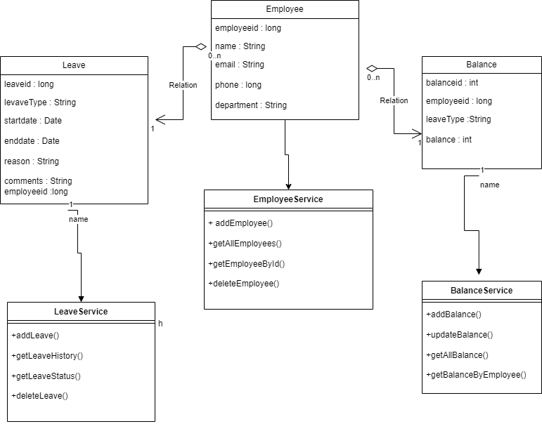
Class Diagram

Slide 14
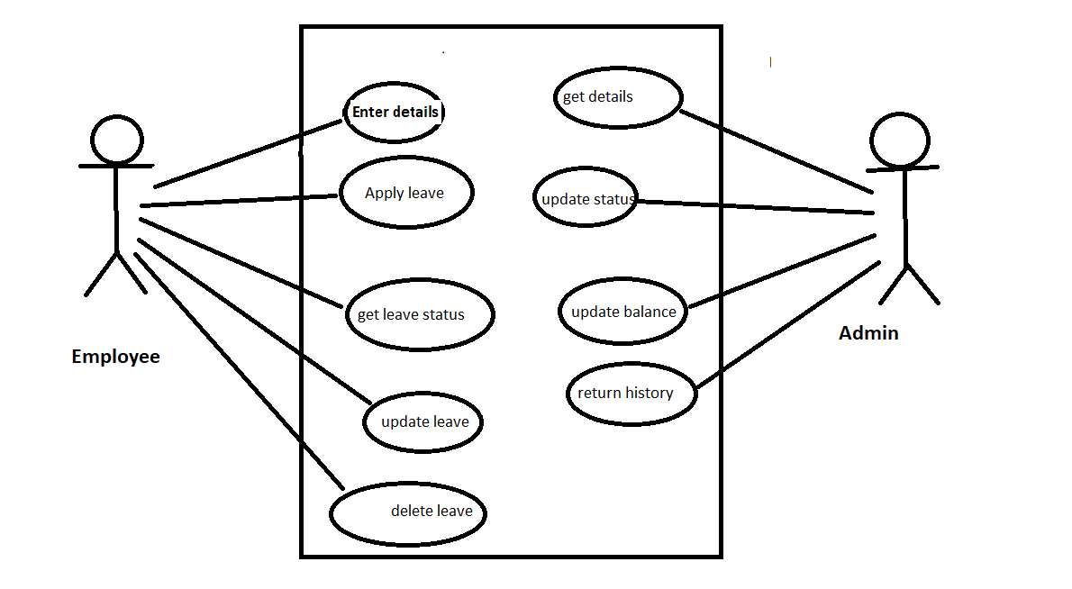
Use Case Diagram

Slide 15
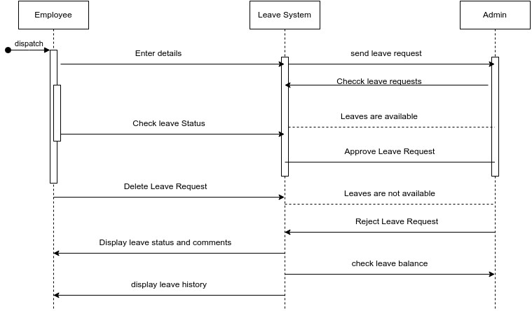
Sequence Diagram

Slide 16

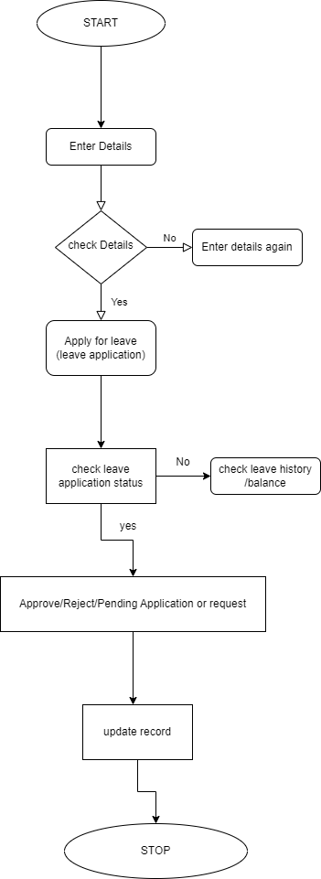
FlowChart

Slide 17
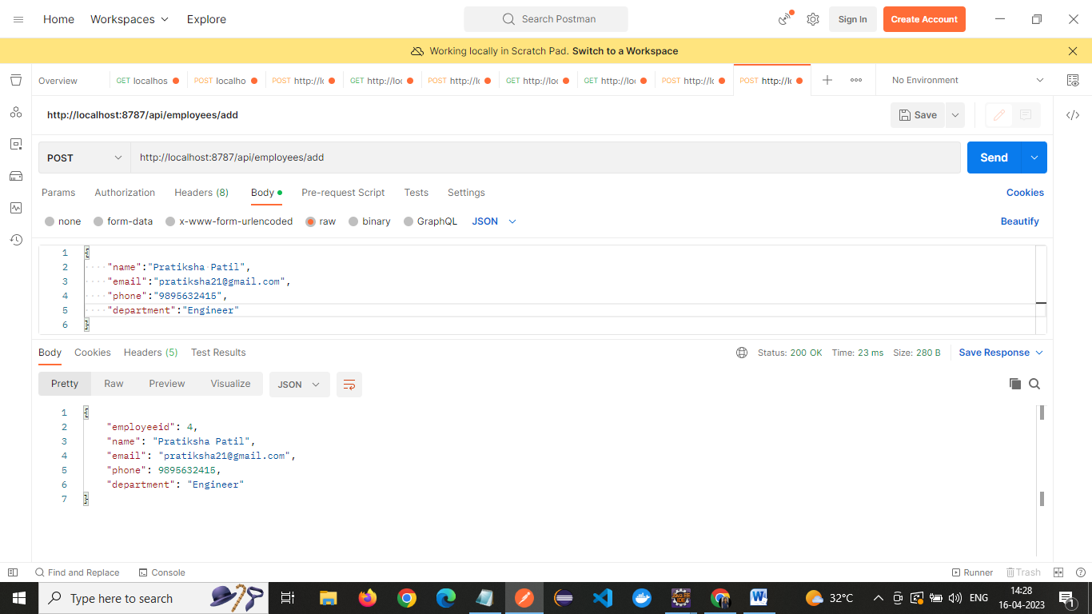
Output: addEmployee()

Slide 18

Output: GetByEmployeeId()

Slide 19
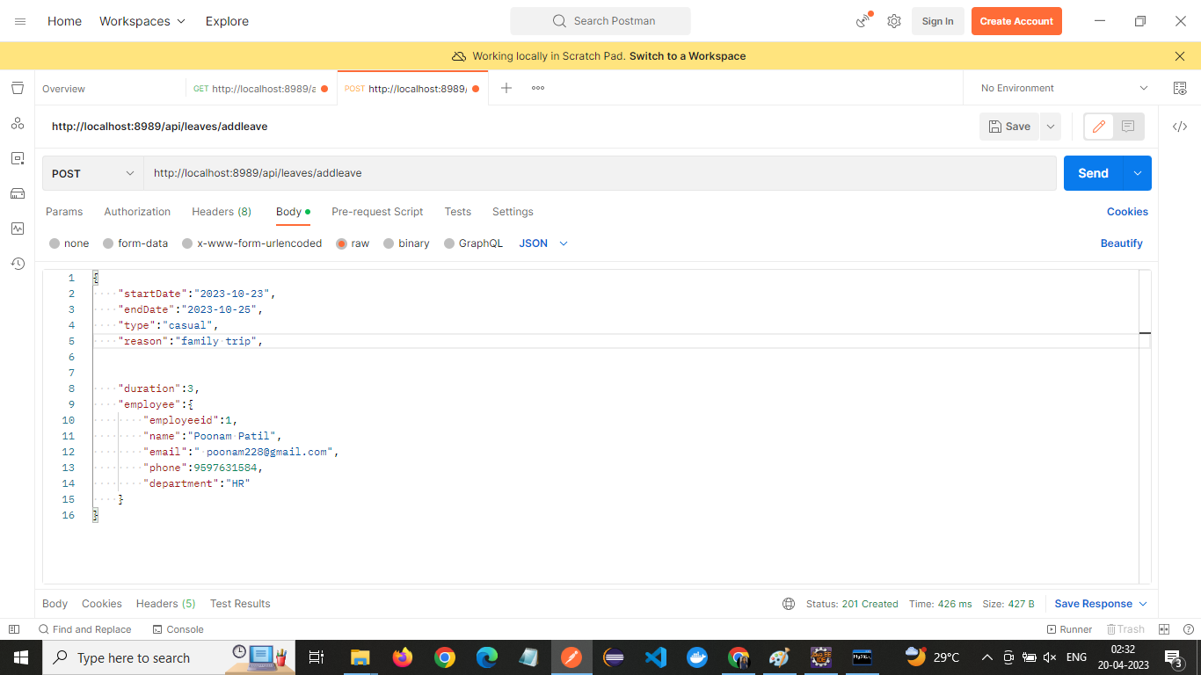
Output: applyleave()

Slide 20
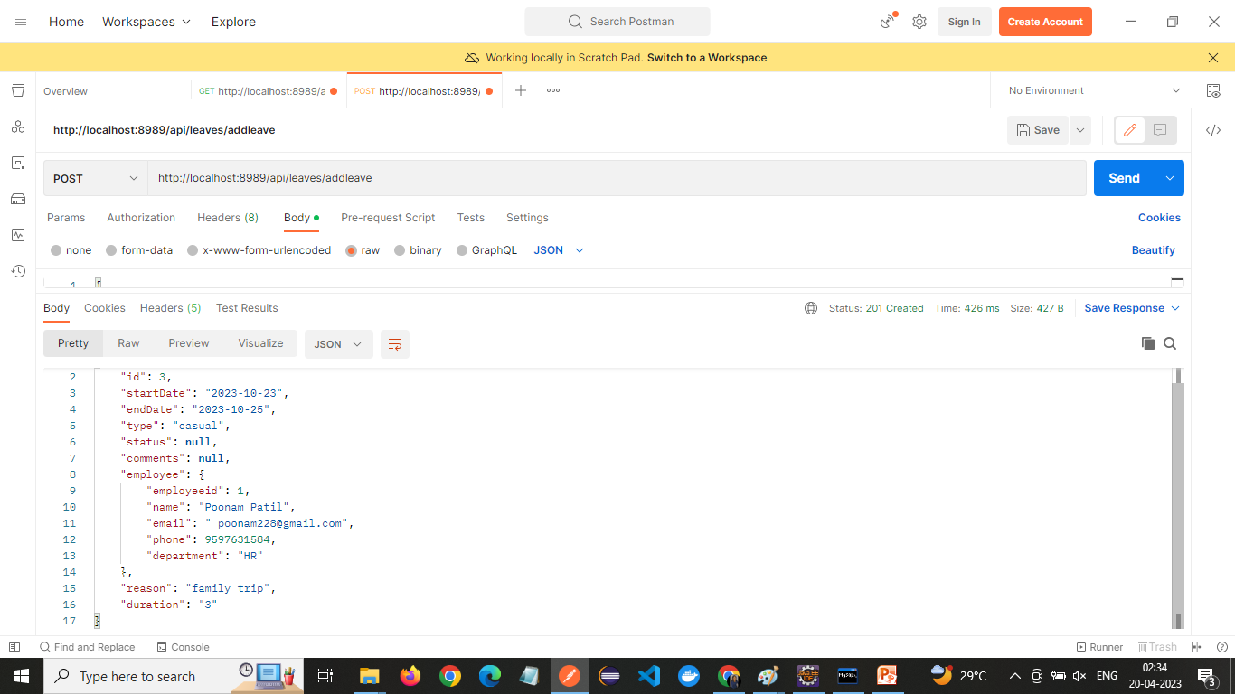
Output: applyleave() Response

Slide 21
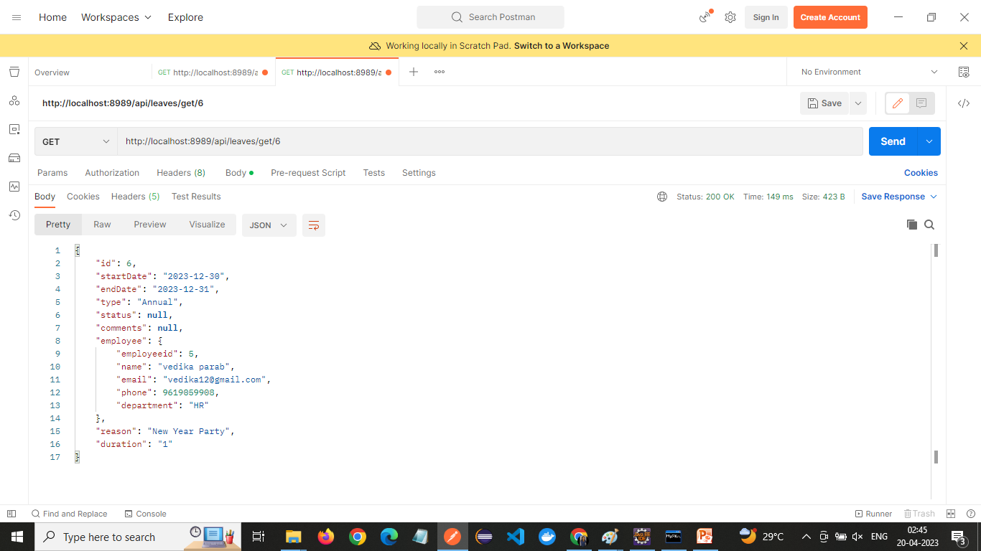
Output: getLeaveById()

Slide 22
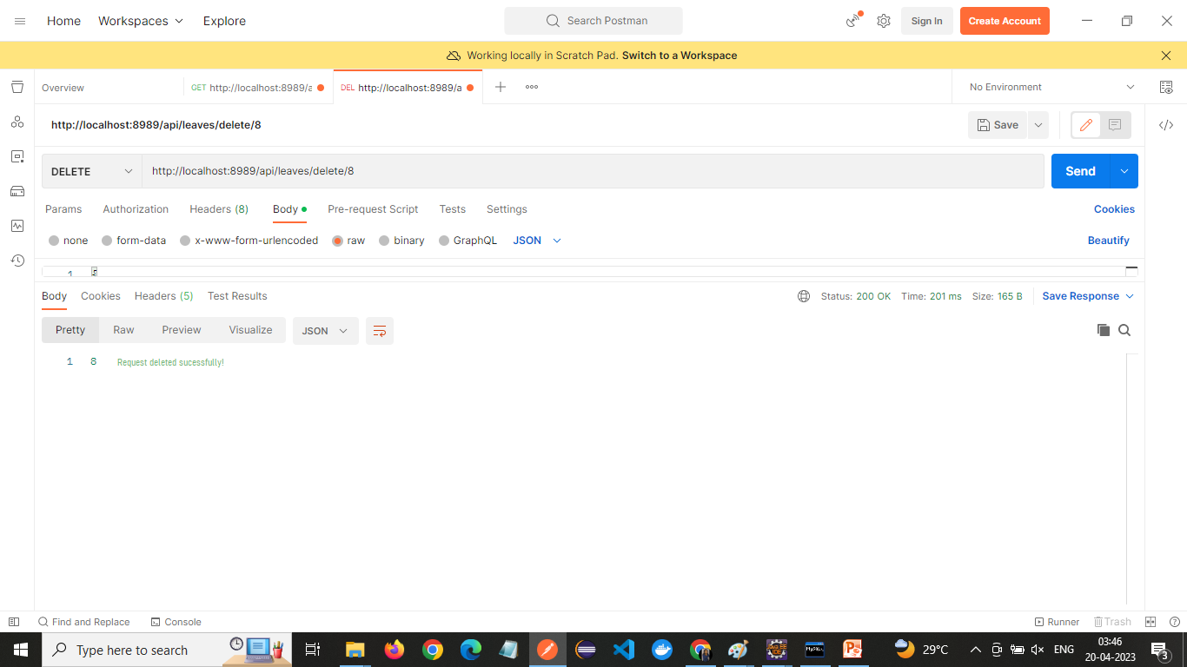
Output: deleteLeaveById()

Slide 23
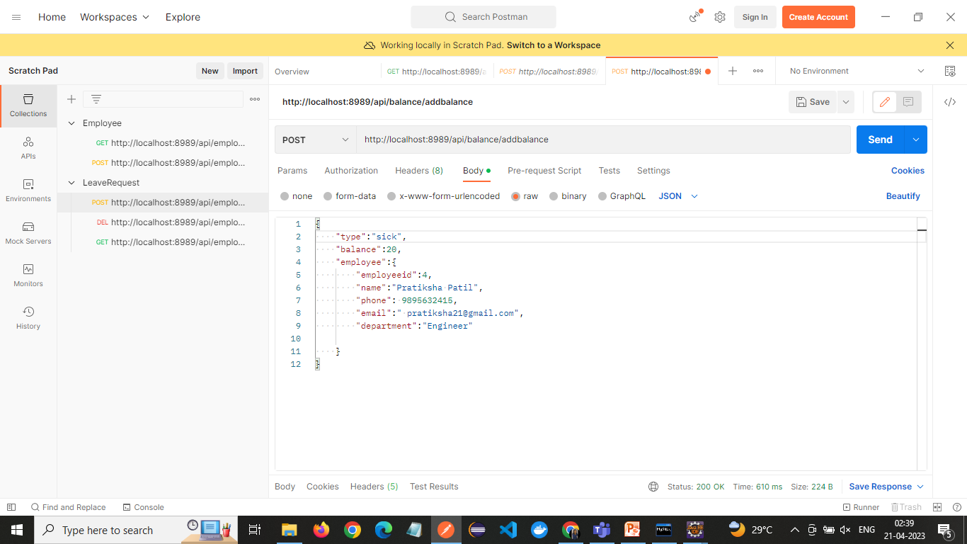
Output: addBalance()

Slide 24
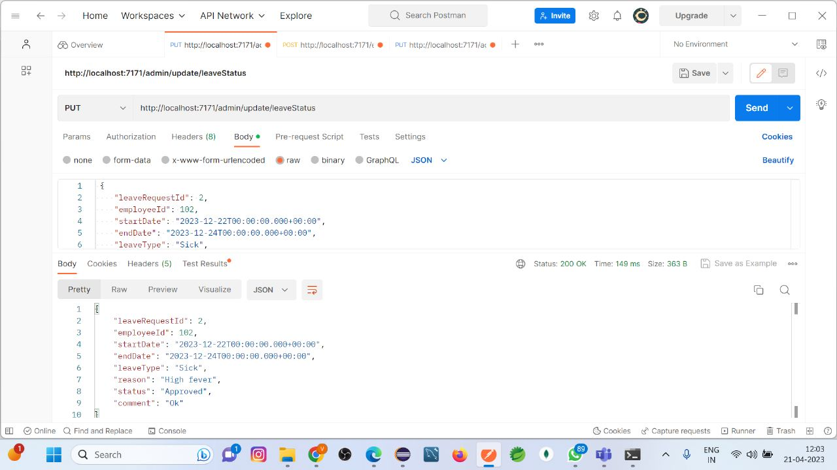
Output: Leaveapprove:

Slide 25
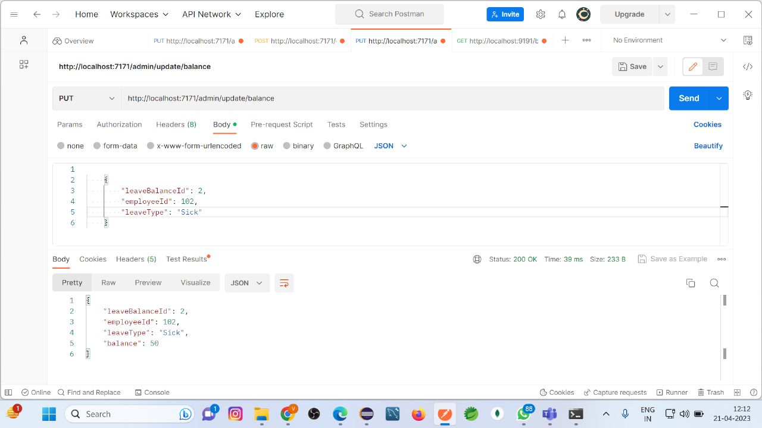
Output: Leavebalance:

Slide 26
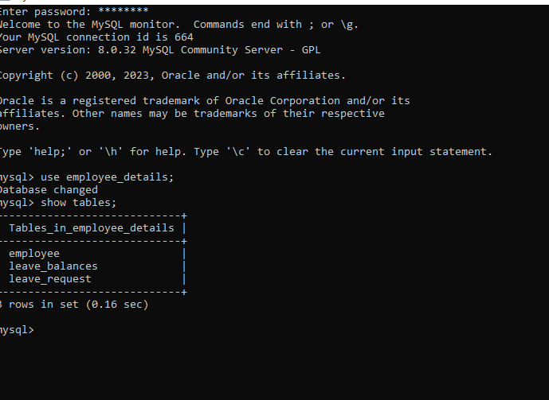



Database Presentation:

Slide 27
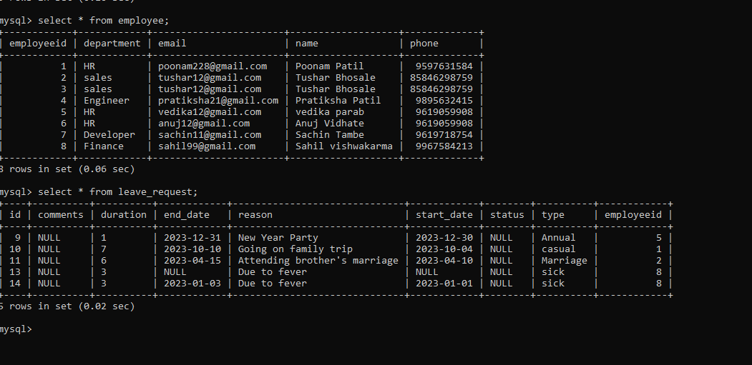
Database Presentation:

Slide 28
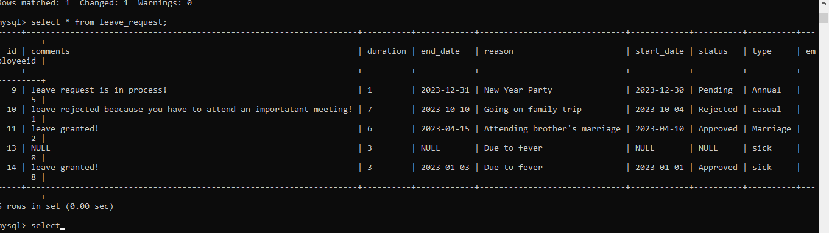
Database Presentation:

Slide 29
A GOOD WAY TO END THE PRESENTATION
Thank You!

